Slide 1
AI
Notes:
It’s exciting. It gets a lot of hype going (which is honestly well-deserved). But it’s not very concrete.
What does AI mean? What does AI actually do?
Let me break it down for you a little bit.

Slide 2
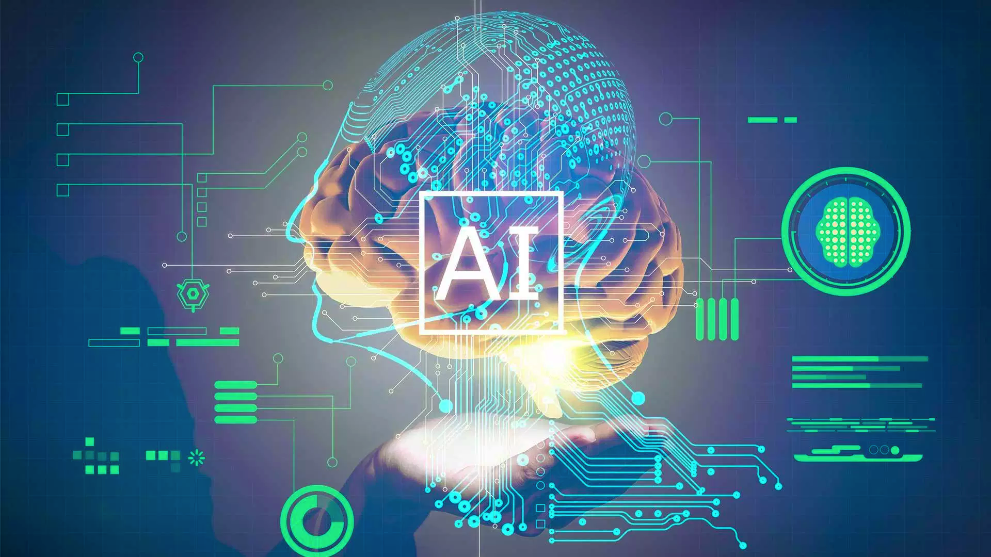
Notes:
The term “Artificial Intelligence” was coined by John McCarthy, an American computer scientist, in 1956 at The Dartmouth Conference.
John McCarthy said that AI is “The science and engineering of making intelligent machines, especially intelligent computer programs”.
So, Artificial Intelligence is a field of computer science dedicated to simulating human intelligence.
The goal of AI is to create a machine that can mimic a human mind.
As of the last 15 years, the main exciting advancements we’re seeing in Artificial Intelligence are coming from a domain called Machine Learning.
So then, what’s machine learning?

Slide 3
…powered by
Machine Learning!
💻👩🏻‍🔬
”Machine learning is the science of getting computers to act without being explicitly programmed, but instead letting them learn a few tricks on their own.”
-- Dr. Danko NIkolic
Notes:
Machine learning is a subfield of Artificial Intelligence.
Technically, machine learning is a method of data analysis that automates analytical model building.
But we can think of it as a technique to train artificially intelligent systems without needing to be specifically programmed.
Instead, you create an algorithm that takes in data and uses statistics to predict an output that’s reasonably correct.
If you’ve bought something on the internet and seen “related products” for you to buy, those suggested products were almost certainly selected using a machine learning algorithm.
Or if you’re on Netflix, and you’ve been watching some shows, and it suggests other shows to check out – they picked those shows using a machine learning algorithm.
Terms are often used interchangeably.
One funny, and true way of remembering the difference, is that when you’re trying to sell a product, you call it AI. When you’re trying to hire someone to build the product, you call it Machine Learning.

Slide 4
Demystifying machine learning
Age | Income | Education | Gender | Housing
61 | $65,000 | Moderate | F | Own
42 | $72,000 | High | F | Rent
18 | $25,000 | Moderate | M | Other
22 | $36,000 | Low | M | Rent
Training data
31 | $52,000 | High | M | ?
What we know
“features”, “attributes”
Thing to predict
“class”, “label”
Notes:
Okay, quick, simple example.
So, like I said, machine learning works through algorithms that take in data and use statistics to predict a reasonably correct output.
As an example, imagine you’re trying to predict whether someone rents or owns their home.
To do this, we’d need a bunch of data about all kinds of people who both rent and own homes.
In this example, we have their age, their income, their education level, gender, and of course, whether they own or rent.
… remember it in a “model”
Then, we use that model – put in all of the features of the person we’re trying to guess about – and the model will give us its best prediction of whether or not that person owns or rents their home.

Slide 5


How to create a predictive ML model
Build
Choose & configure your model
Clean
data
Filter
data
Train
Use your training dataset to build the model
Test
Use your test dataset to validate the model
Predict
If the model is good enough, use it!
Notes:
ML starts with data which can come from a variety of sources. You might pull-in a large static dataset like historical weather temperatures or on-time flight arrivals in order predict a likely outcome like global climate change or whether your flight from Chicago will arrive on time. There are also tools to capture and stream real-time data. Say you’re in a car race and telemetry is coming-in a 1GB per second. If you could build a model that could predict when a pitstop is most needed based on “features” like tire pressure, fuel, and engine temp, would that be the difference between winning or not (or at least NOT crashing the car)? ☺
Most data typically needs to be "cleaned" before it is used. Examples of cleaning include removing rows with missing data, replacing missing data algorithmically, removing duplicate rows, and removing rows containing "outliers." Data scientists will also perform “feature selection” or more advanced, math-intensive “feature engineering”– in which you’re optimizing your dataset to maximize its training potential. In practice, all of this can be very time-intensive and often consumes 50%-80% of the time required to build the model.
Once the data is ready, you select an algorithm and "train" the model by allowing it to iterate over the data and find patterns in it. After that comes scoring and evaluating the model, which tells you how well the model is able to predict outcomes. Machine Learning is a trial and error process but fortunately there are some amazing open source tools & libraries to help you do so. You might have heard of the term “deep learning” – this often refers to specific algorithms that can be used with popular frameworks like Keras, Tensorflow, and CNTK. To build the ground-breaking predictive models with huge datasets, that’s also where the compute potential and flexibility of a cloud platform like Azure comes in.

Slide 6
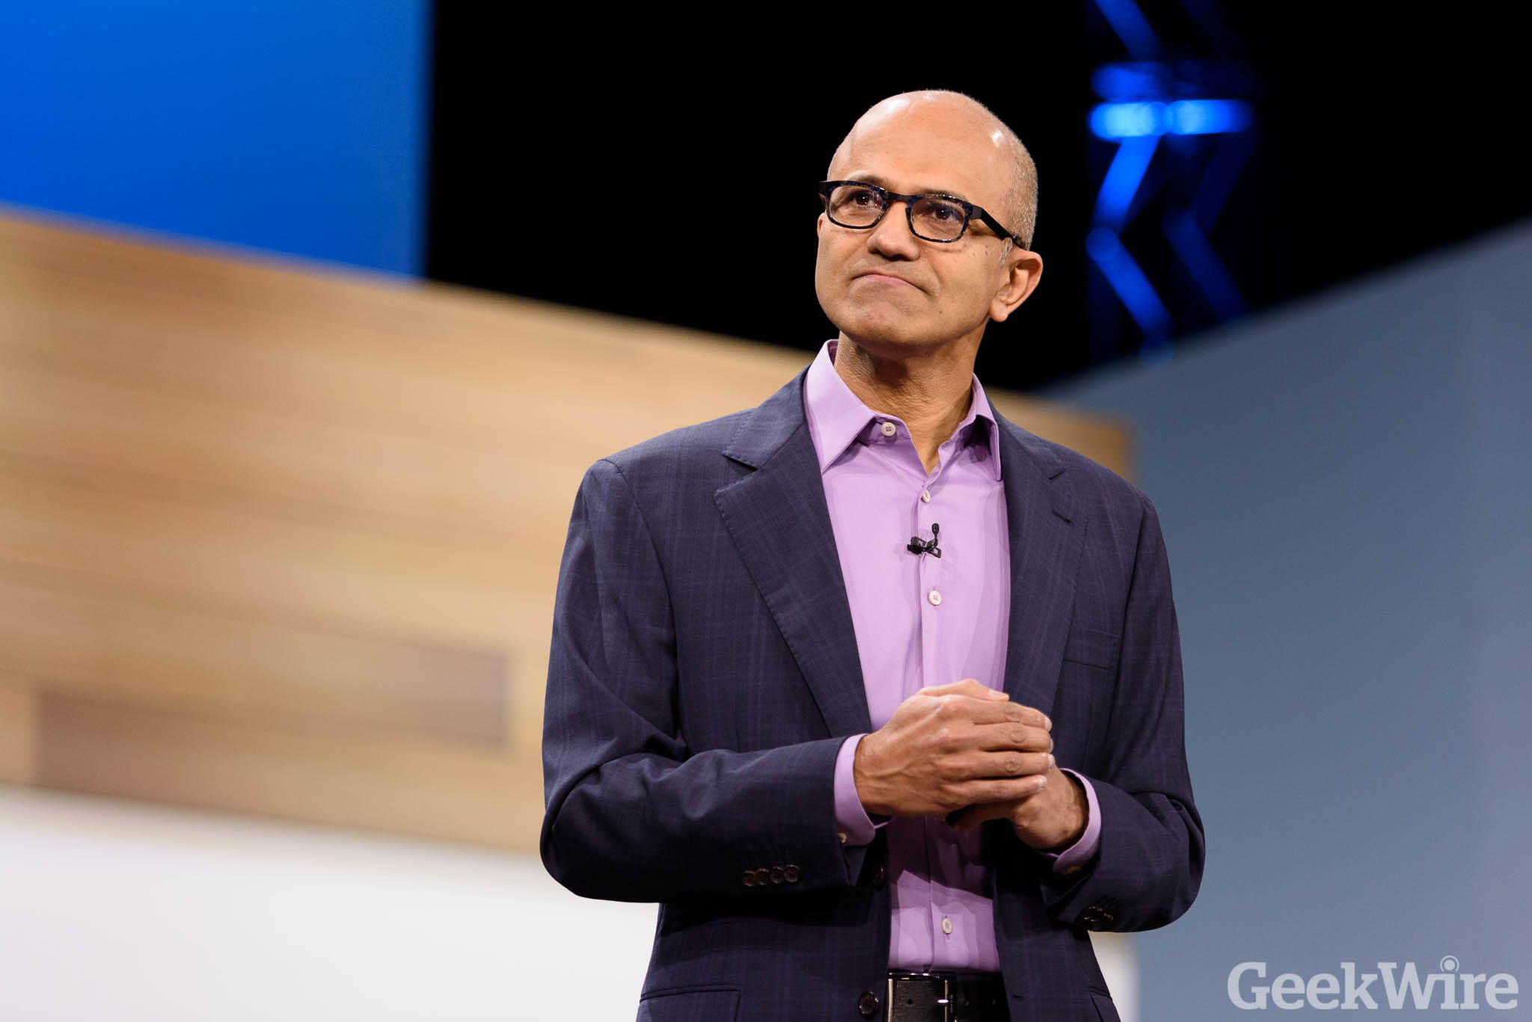
Microsoft’s aim:
Making AI available to everyone
We are pursuing AI to empower every person and every institution ... so that they can go on to solve the most pressing problems of our society and our economy.
– Satya Nadella, CEO, Microsoft
Notes:
My take on this (and Microsoft’s take as well ☺) is that we should be using AI to enable and empower everyone.
I think of Microsoft as doing this in three main ways:
Creating products that use AI in innovative ways enable all users
Building tools that developers such as yourselves can use to create (I’ll be showing you how to use some of these tools later)
Actively contributing to the global dialogue of ethical implications of AI. We believe AI should augment human capability – help us eliminate mundane and repetitive tasks and instead be more productive and creative. Harnessing its potential also requires us to adopt an open & questioning mindset. We have a shared responsibility to ensure that that the models that we build (and the AI experiences that consume them) are fair, reliable and safe, private and secure, inclusive, transparent, and accountable. We’re working with technology communities, governments, universities, and organizations on this.
//additional narrative on AI in Ethics: https://news.microsoft.com/futurecomputed/
//optional bridge to Microsoft Mission slide, see appendix

Slide 7




Microsoft AI for Good
Notes:
//to prep for talk track on this slide, see https://www.microsoft.com/en-us/ai/ai-for-good. Videos are particularly good. This is about rich storytelling and personal connection to technology. Speaker can fill 20 seconds or 5 minutes according to preference.
AI for Good is Microsoft’s commitment to providing technology, resource, and expertise to empower those working to solve humanitarian issues and create a more sustainable and accessible world.
$115M in grants over next few years:
AI for Earth $50M
AI for Accessibility $25M
AI for Humanitarian $40M
//talk about your favorite examples and what they mean to you personally and profesionally
AI for Humanitarian Action will harness the power of AI to focus on four priorities – helping the world recover from disasters, addressing the needs of children, protecting refugees and displaced people, and promoting respect for human rights.
Project Premonition
AI technology and cloud software enables Project Premonition researchers to detect and track pathogens to prevent outbreaks and protect biodiversity.
Operation Smile gives hope to more children
Nonprofit partner Operation Smile uses a facial modeling algorithm and Microsoft Pix to improve their surgical outcomes and help more children in need of facial surgeries.
The Yield
How do we feed the world without wrecking the planet? The Yield uses Microsoft AI to help farmers create localized predictions, so they know exactly when to plant, when to water, and when to harvest to create more food and less waste.
Iconem
Historical sites are disappearing every day. The team at Iconem uses Microsoft AI to help preserve ancient architectural sites for future generations.

Slide 8
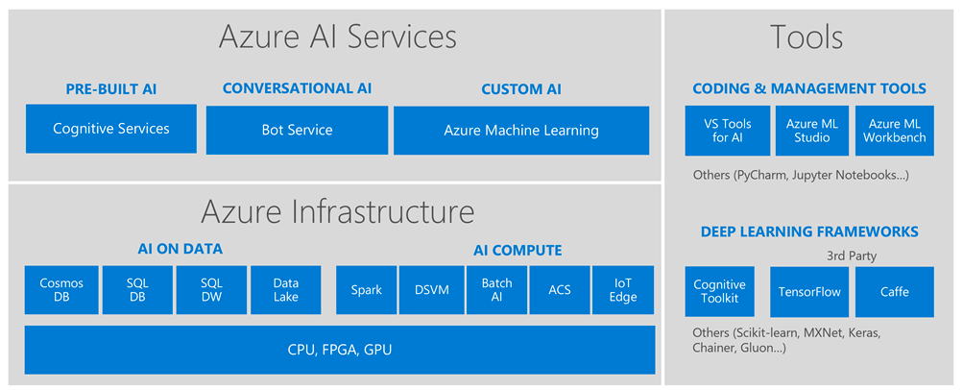
Microsoft AI Platform
Notes:
So what does this all mean to you as a developer? It’s means that Microsoft has already created the “building blocks” for you to work with AI.
And you don’t have to be an expert coder to start building with it:
AI services: Use these high-level “finished” services to add intelligence to your apps. For example:
With Cognitive Services, you can leverage pre-built intelligent algorithms to see, hear, speak, understand, and interpret users’ needs through natural methods of communication.
With an intelligent back end like Language Understanding Intelligent Service (LUIS) and the Bot Framework, you can build, connect, deploy, and manage conversational AI for intelligent bots with Azure Bot Service to interact naturally with users on websites and in apps.
LUIS allows you to recognize meaning fron matural language so users can use natural language to interact with your apps
AI tools: If you want to start exploring training your own machine learning models but don’t have a lot of coding experience, you’re already learned about Azure Machine Learning Studio, the drag and drop tool for training and deploying predictive models. Btw it also support custom Python and R coding modules.
Maybe you have already started learning python Pandas and tools like Sci kit learn to train your own models.
AI infrastructure:
Tools like Azure Data Lake allow you to access data from multiple data sources to train your models. You might already be familiar with the basics for databases through SQL Server or Blob storage.
The Data Science Virtual Machine saves you time with pre-installed tools (more on that later)
AI tools:
Azure ML Workbench allows you to write your own Python code to train models
Azure notebooks is the Azure implementation of Jupyter notebooks
Or maybe you’re ready to build your own models and algoritms on “bare metal” infrastructure
AI infrastructure:
Open source tools like Apache spark are supported on Azure
Batch AI allows you to train models on clusters of virtual machines
Azure Container Service can help you manage your Kubernetes environment
AI tools:
Azure supports open source frameworks like Tensorflow and Caffe where you can use neutral networks to train your models
Keras in another good solution for rapid prototyping
Cognitive Toolkit is Microsoft’s own framework for deep learning which is design for the largest datasets with performance in mind
[Ad-lib with 1-2 more inutes; share your personal favorite or recent project integrating them]

Slide 9
I’m at a hack. What should I use?
Microsoft AI Platform
Build your own or consume pre-trained models?
Build your own model
Use pre-built models
Azure Machine Learning
Cognitive Services, Bot Services
Customize?
Which experience do you want?
Code-first
Visual-tooling
Tools & Services
Machine Learning
Workbench + Services
Machine Learning Studio
What engine(s) do you want to use?
SQL Server
Spark
Hadoop
Azure Batch
DSVM
Azure Container Service
Notes:
But we’re a hack and that means you have limited time. Here’s a handy flowchart for picking the right AI tool for your goals.
It ultimately comes down to two choices:
Do you want to build your own model?
How much code do you want to write?
Our Microsoft mentors here can also help get your pointed in the right direction.
//pause to make sure audience has enough time to scan the slide.

